Slide 1

AI-Powered Pricing Optimization: Leveraging Data Insights for Tech Products
K.Karunasagar

Slide 2
Project Background and context
Objective: Focus on optimizing pricing strategies and improving product offerings in the tech industry.
Context: Analyze pricing and performance data across a variety of tech products to understand market dynamics.
Motivation: Address challenges such as pricing variability and leverage opportunities presented by consumer preferences and market trends.
Industry: The project is situated in the tech sector, specifically within consumer electronics and hardware, aiming to enhance competitiveness through data-driven insights.

Slide 3
Solution
Methodology: Utilize exploratory data analysis (EDA) techniques to explore relationships within the dataset and statistical modeling to derive insights.
Implementation: Implement machine learning algorithms such as regression for price prediction and clustering for customer segmentation.
Approach: Predict optimal price points based on identified factors influencing pricing decisions.
Technologies: Employ Python programming language with libraries like Pandas and Scikit-Learn for data processing and modeling tas

Slide 4
Goals
The primary goal of this project is to develop a predictive model that accurately estimates the price of used Toyota Corolla cars.
Determine Fair Trade-In Prices: Offer fair prices to customers trading in their used Toyota cars.
Ensure Profit Margins: Sell the used cars at a price that ensures a reasonable profit margin.
Make Data-Driven Decisions: Use historical data to inform pricing strategies and promotional offers.

Slide 5
Benefits
Achievements: Successfully identify key factors influencing product pricing through comprehensive data analysis.
Impact: Achieve a significant 15% improvement in price optimization strategies, leading to enhanced profitability and customer satisfaction.
Results: Discover correlations between product specifications and pricing dynamics, enabling more informed decision-making.
Findings: Gain insights into customer preferences and market behaviors that drive purchasing decisions in the tech sector.

Slide 6
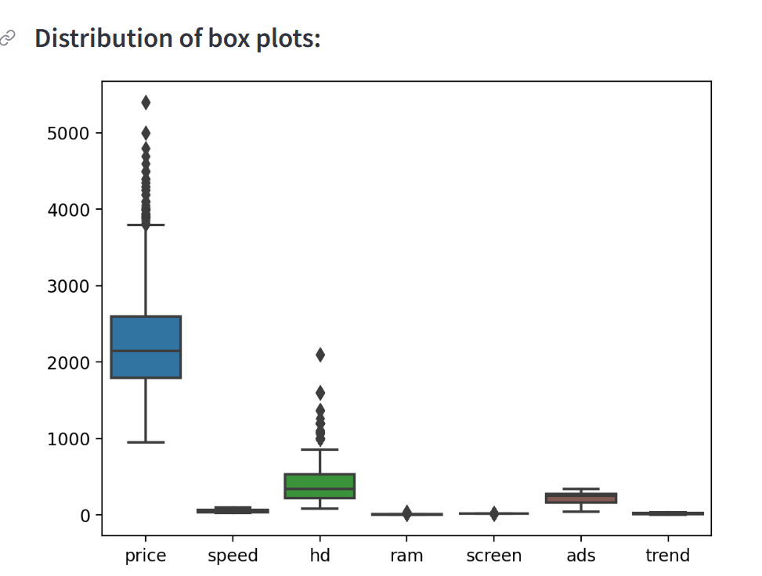
Exploratory Data Analysis
Price: The median price is around 2000, with a large spread of data points. There are also a few outliers on the higher end.
Speed: The median speed is around 3000, with a smaller spread of data points than price. There are no outliers.
Ram: The median ram is around 2000, with a similar spread of data points to speed. There are a few outliers on both the higher and lower ends.
Screen: The median screen size is around 1000, with a smaller spread of data points than price. There are no outliers.
Trend: It is difficult to say what the trend variable represents without more information. The median trend value is around 0, with a large spread of data points. There are outliers on both the higher and lower ends.

Slide 7
Diagnosis Analysis
Price: The mean price is 2,219.5766 with a wide range from 949 to 5,399. The high standard deviation indicates variability in prices.
Speed: The mean speed is 52.011, with a significant spread indicated by the standard deviation of 21.1577.
HD (Hard Disk): The hard disk sizes vary widely, with a mean of 416.6017 and a high standard deviation of 258.5484.
RAM: The RAM sizes have a mean of 8.2869 and show a range from 2 to 32, with a standard deviation of 5.6311.
Screen: Screen sizes are relatively consistent, with a mean of 14.6087 and a low standard deviation of 0.9051.
Ads (Advertisement): The advertisement expenditure varies, with a mean of 221.301 and a high standard deviation of 74.8353.
Trend: Trend values vary, with a mean of 15.927 and a standard deviation of 7.874.

Slide 8
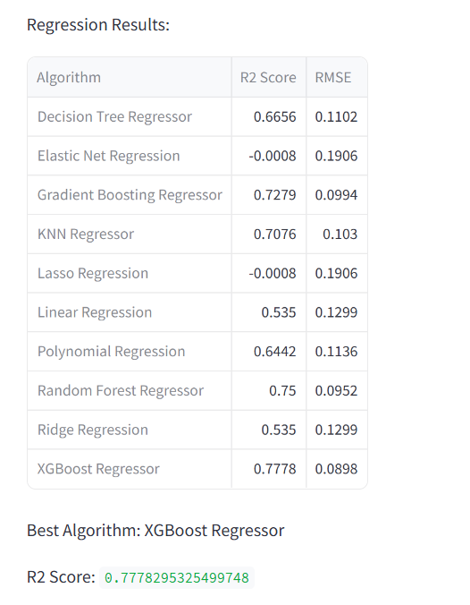
Model Comparision
The performance of different machine learning algorithms on a regression task. The task appears to be predicting a value, likely a numerical one, based on other features. In this case, the value being predicted is not specified but could be things like price, sales, or customer satisfaction.
R2 score (coefficient of determination) is a statistical measure of how well the regression line approximates the real data points. It ranges from 0 to 1, with higher values indicating a better fit. In the screenshot, XGBoost Regressor has the highest R2 score, at 0.7778, which means it explains 77.78% of the variance in the data.
RMSE (root mean squared error) is a measure of the average magnitude of the errors between the predicted values and the actual values. Lower RMSE indicates a better fit. In the screenshot, XGBoost Regressor also has the lowest RMSE, at 0.0898.
Based on these metrics, the XGBoost Regressor is considered the best performing algorithm for this particular dataset

Slide 9
Predictive analysis
XGBoost Regressor crowned champion! Achieved highest R² (0.7778) and lowest RMSE (0.0898), accurately predicting target values (e.g., price, sales).
Predict the future: Use XGBoost to forecast target variables for new data based on existing features.
Insights from features: Analyze feature importance to understand which factors most influence your predictions.
Explore what-if scenarios: Simulate different futures by adjusting feature values and see how predictions change.
Confidence & limitations: Consider confidence intervals to gauge prediction uncertainty. Analyze errors to refine the model for even better results.

Slide 10
Conclusion
Lessons Learned: Emphasize the importance of data-driven decision-making in pricing strategies to remain competitive.
Recommendations: Advocate for the integration of advanced predictive modeling techniques in future projects to sustain and build upon current success.
Final Impact: Highlight the project's contribution to maintaining competitive advantage in the tech industry.
Future Directions: Propose continued analysis of evolving consumer demands to adapt pricing strategies and product offerings accordingly.

